Slide 1
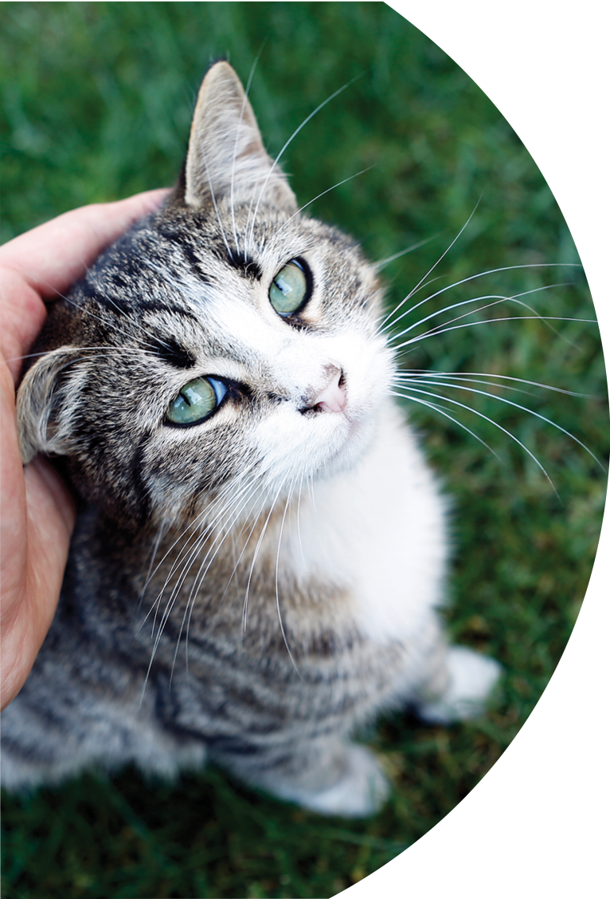

EVDI Online Congress 2020
Film Reading Session
powered by
Yseult Baeumlin
DVM DipECVDI
Ilva Drumm
Dr. med. vet. MS DipACVR

Slide 2
Case 1
Signalement:
Ghost, 8yo, M, German Shepherd
History:
Hyperthermia and anorexia

Slide 3
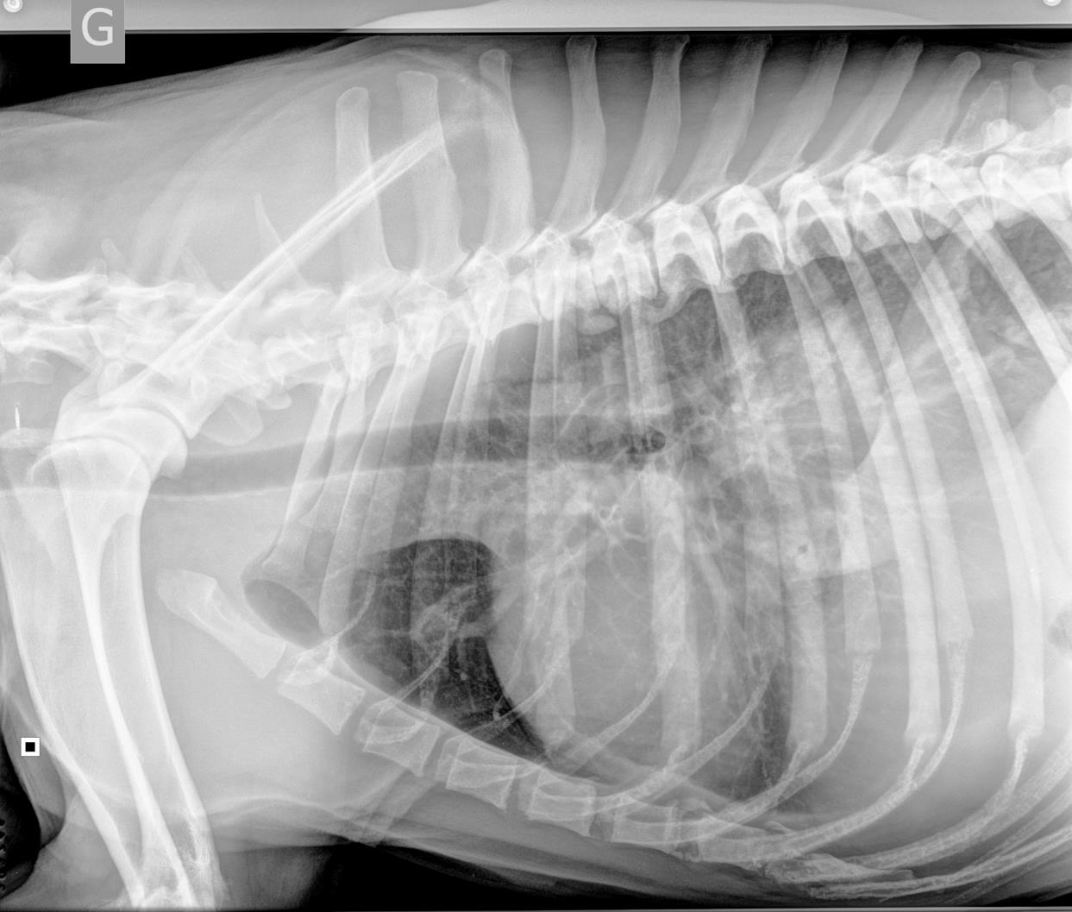

Slide 4
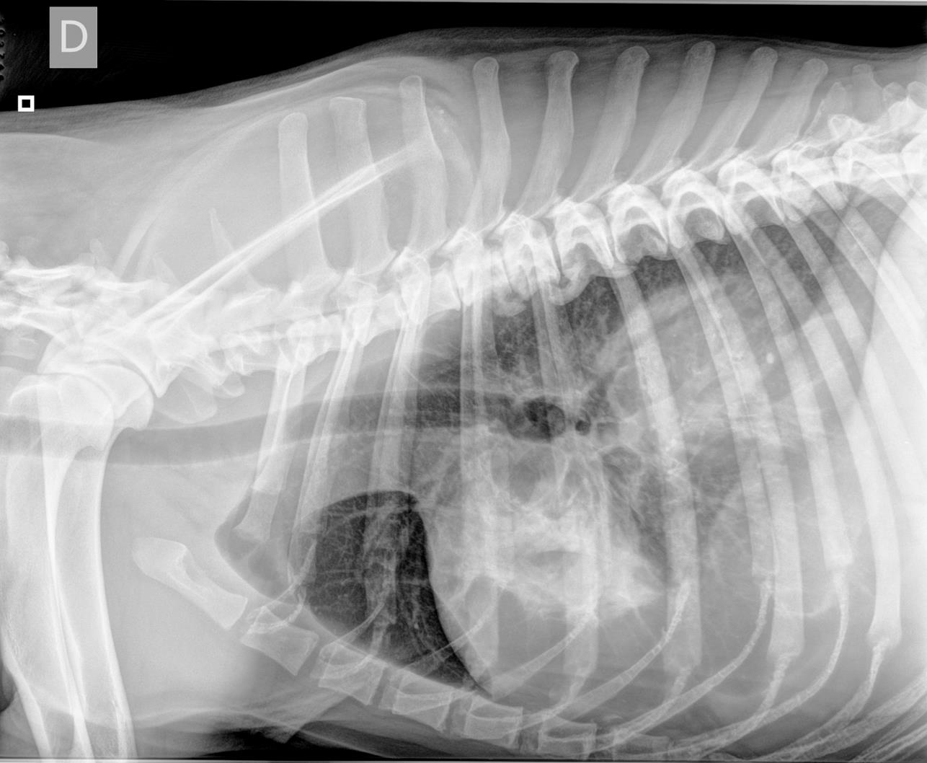

Slide 5
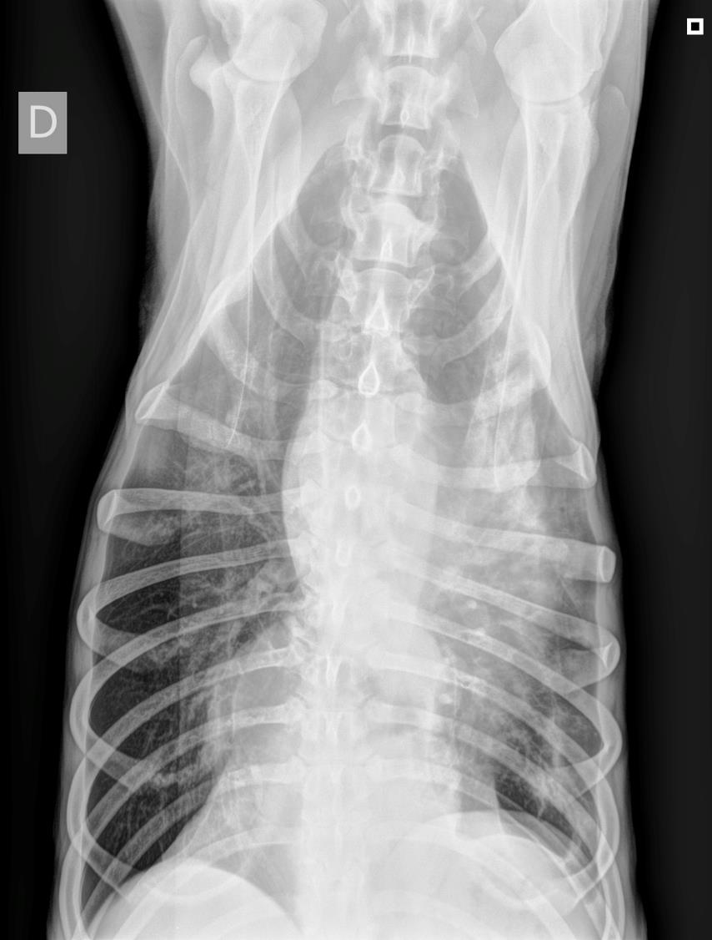

Slide 6


Slide 7
Case 2
Signalement:
Tom, 7yo, MC, Bichon Frisé
History:
Swelling of both maxillae
Inspection of mouth normal

Slide 8
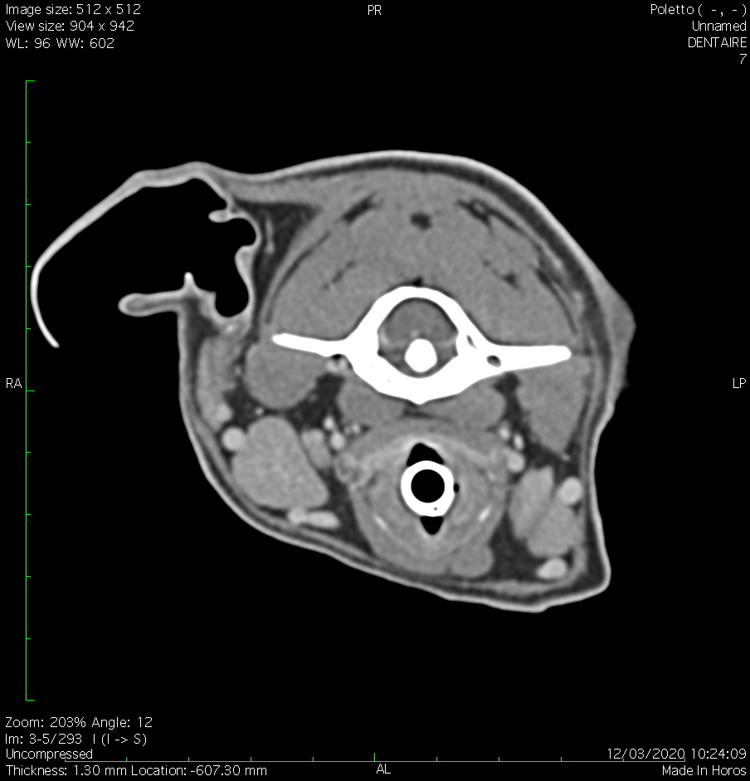
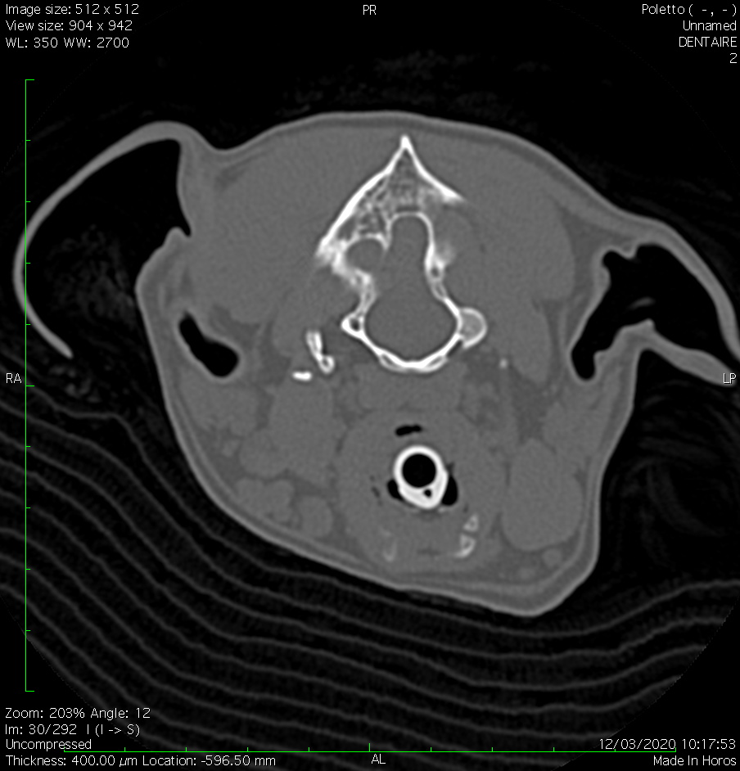

Slide 10
Case 3
Signalement:
1 year-old, male, canine
History:
respiratory distress

Slide 11
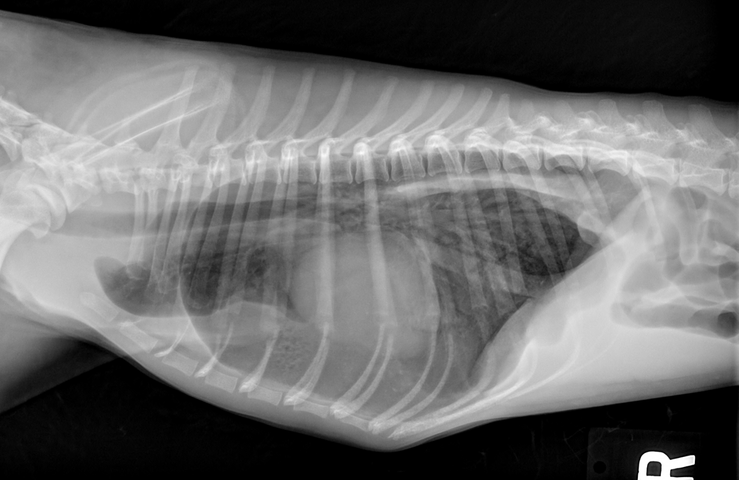

Slide 12
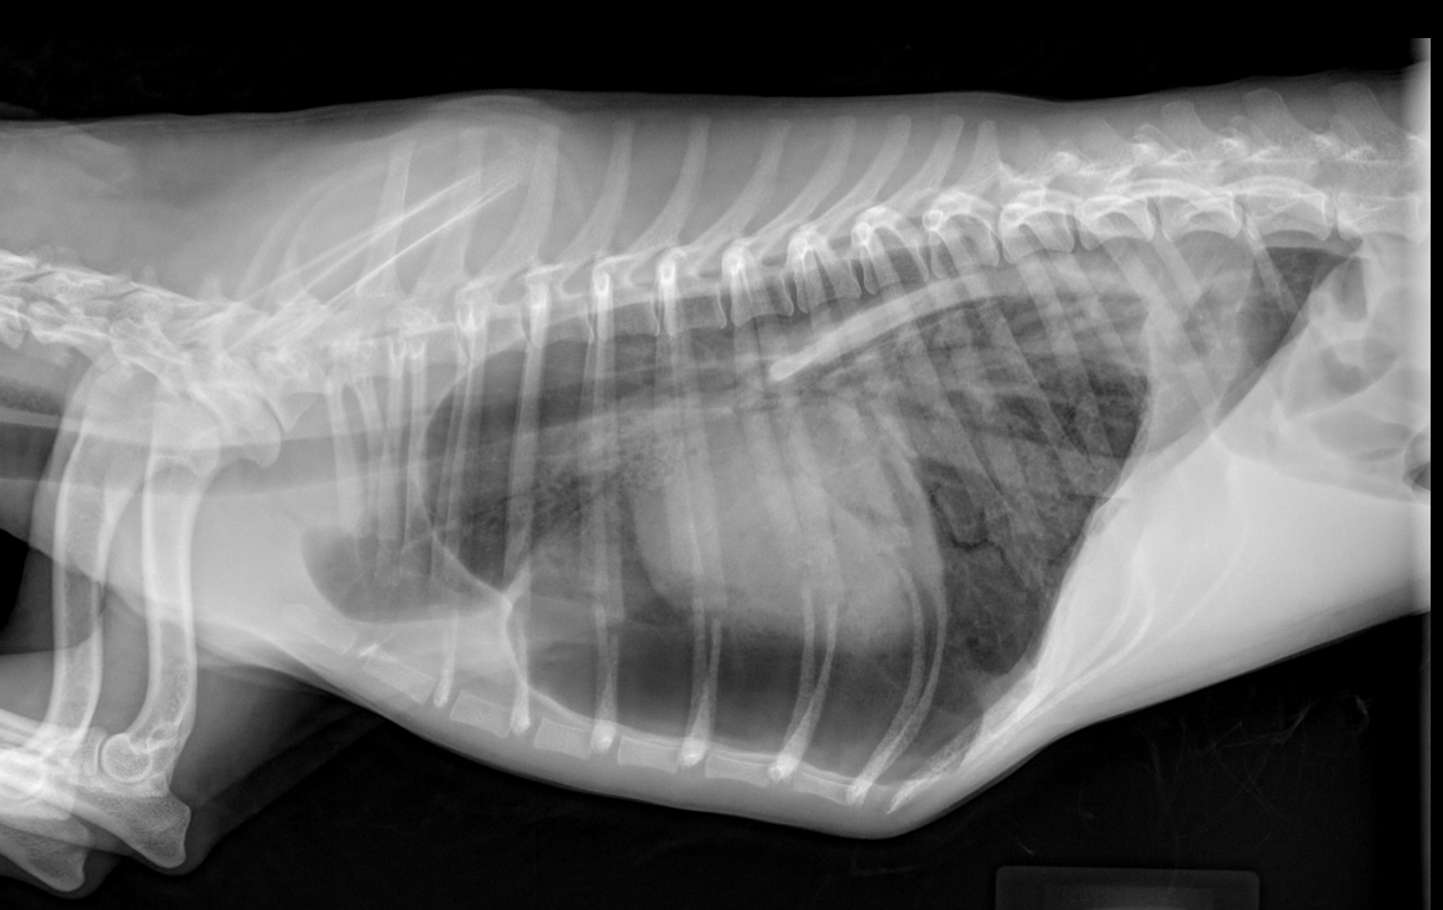

Slide 13
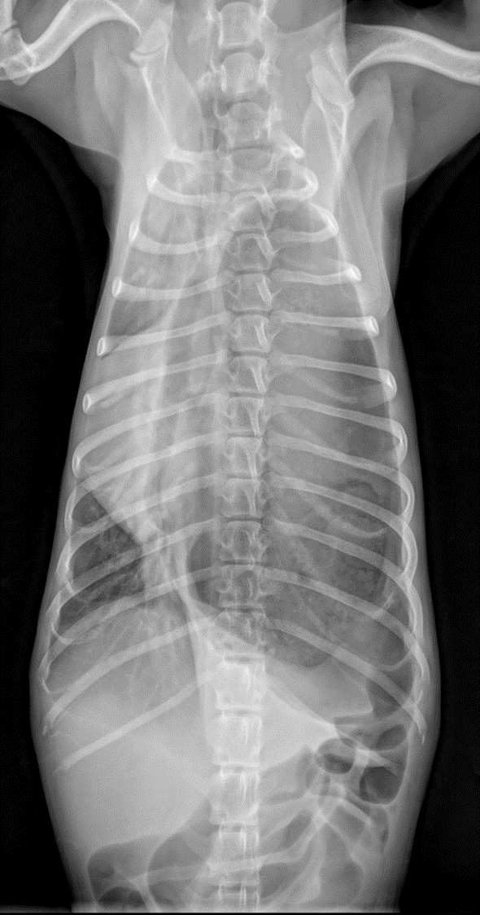

Slide 15
Case 4
Signalement:
5 year-old female-spayed Siberian Husky
History:
Mydriasis OD for 3 months; five recent seizures, circles to the right; CBC and chemistry normal

Slide 16
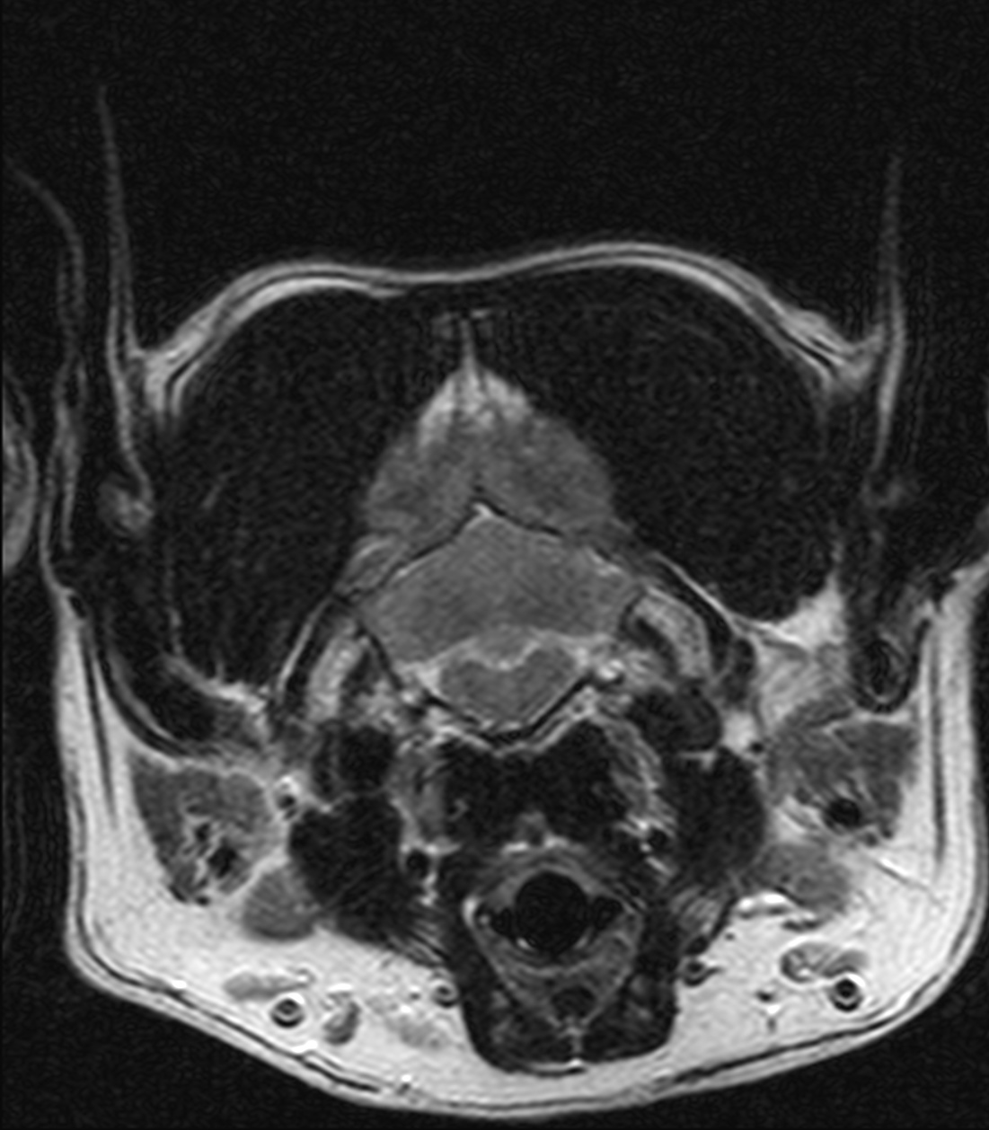
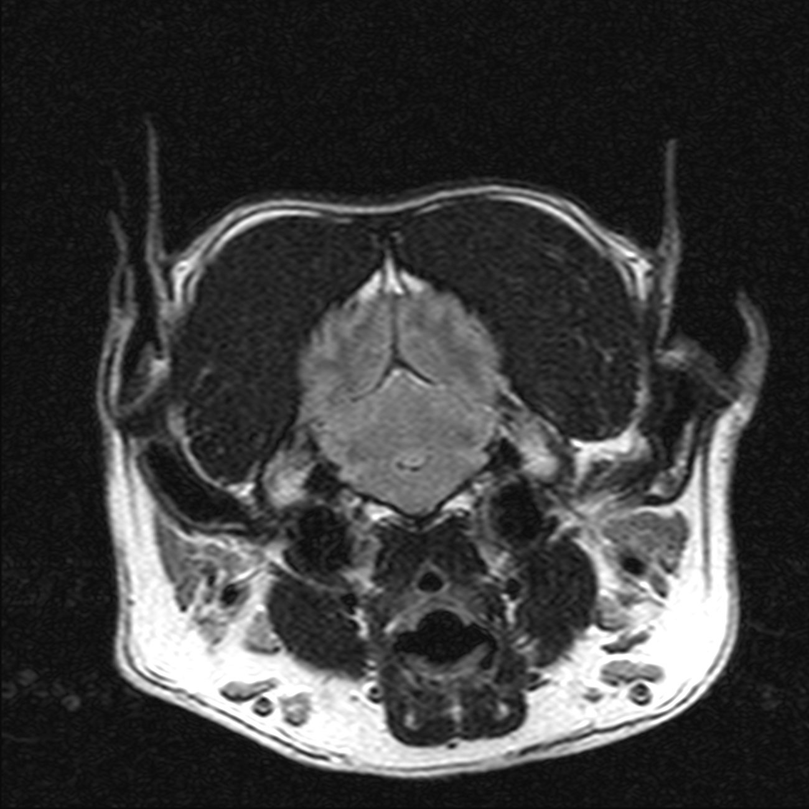

Slide 17
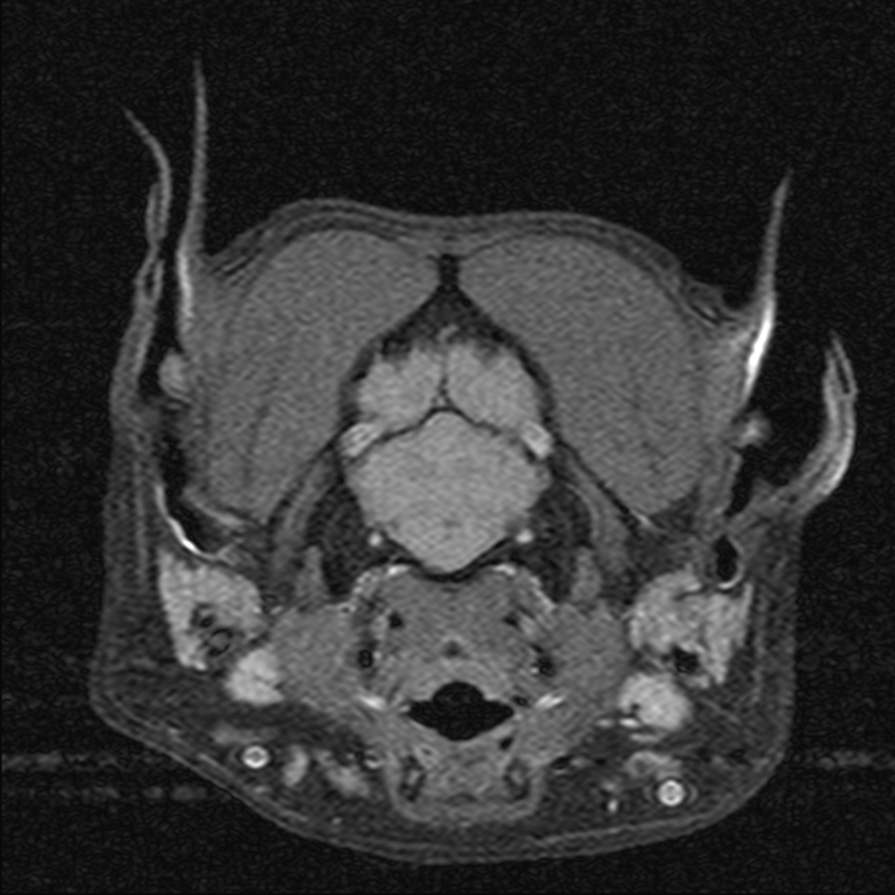
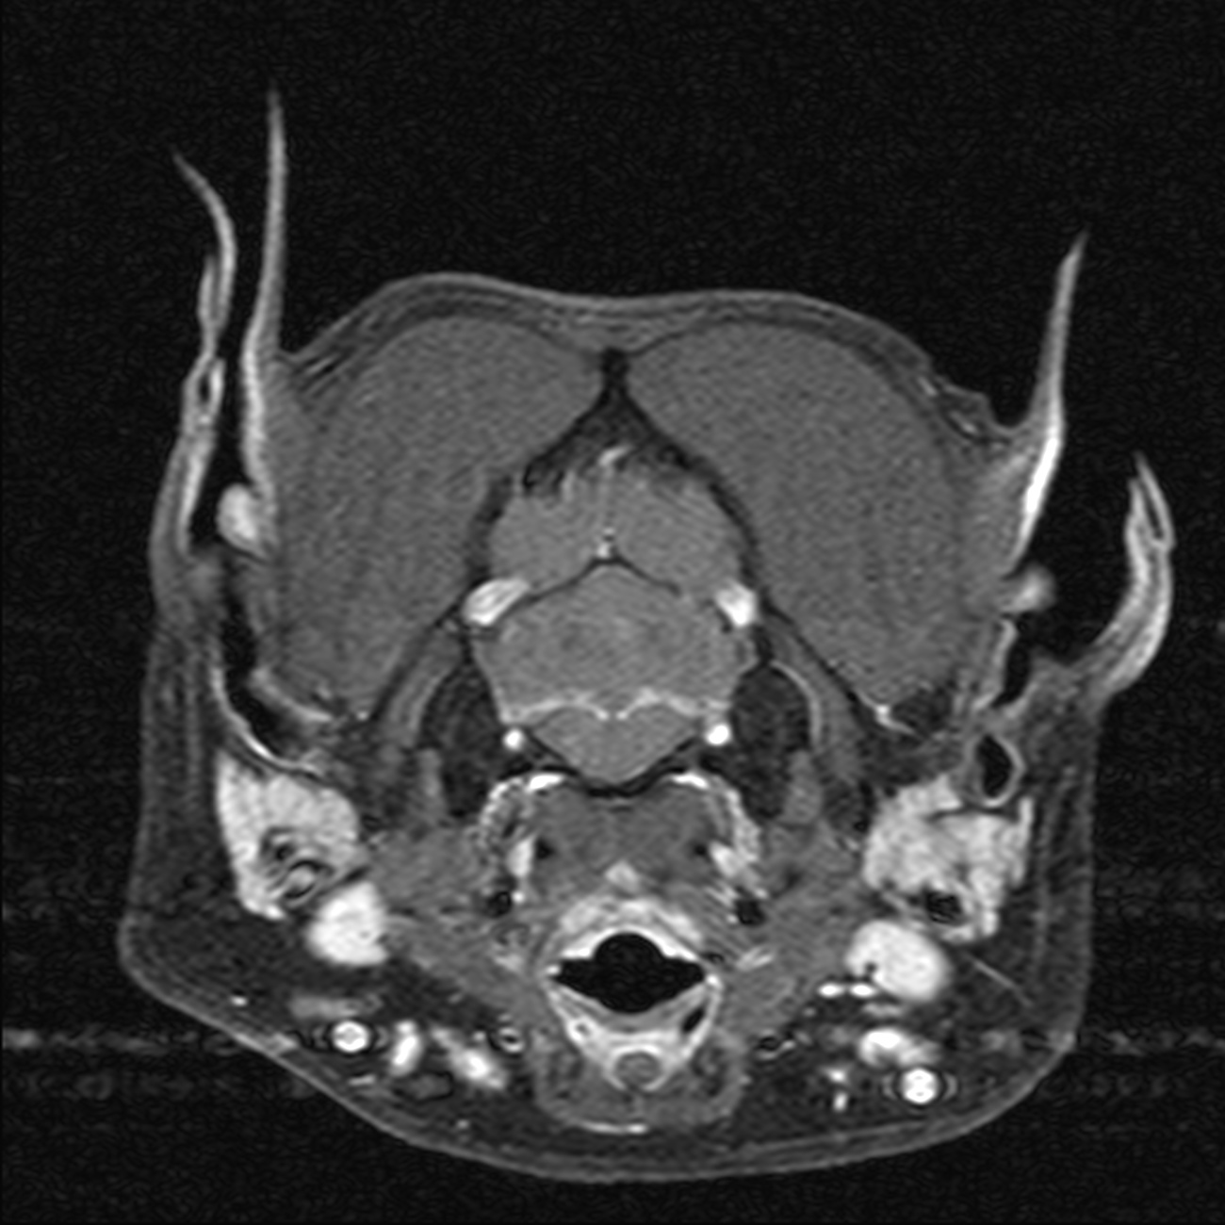

Slide 18
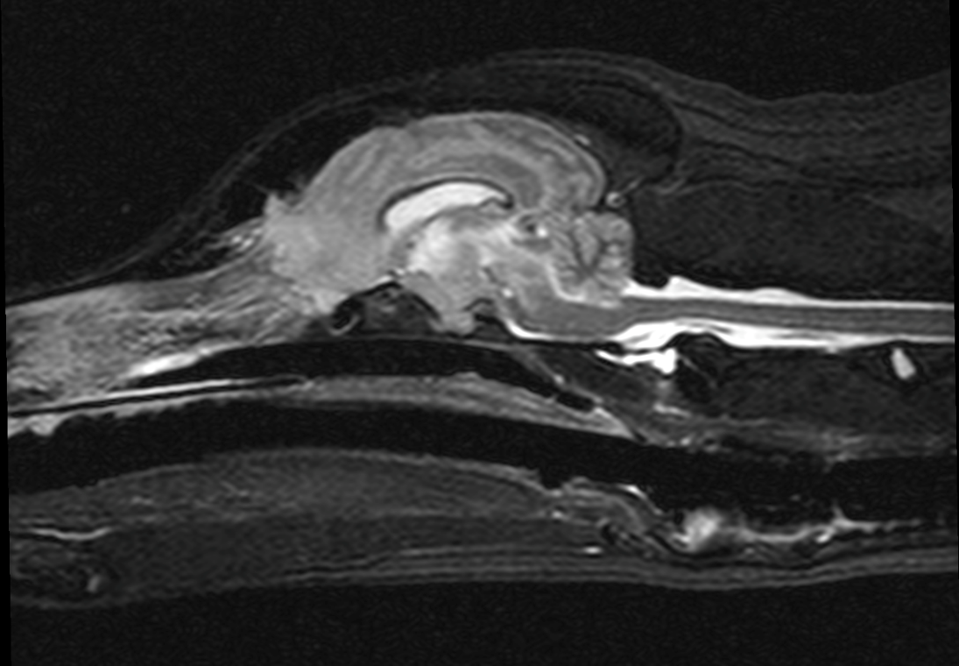
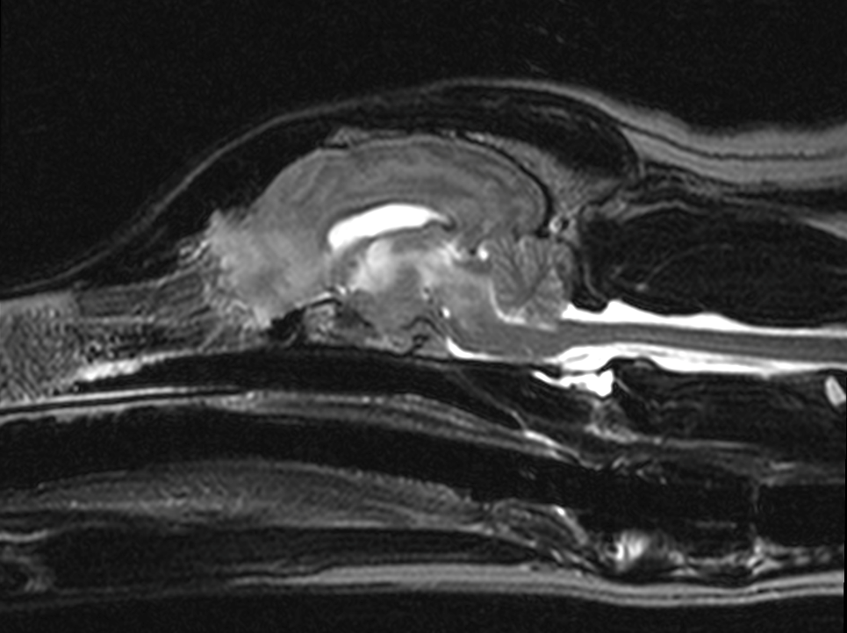
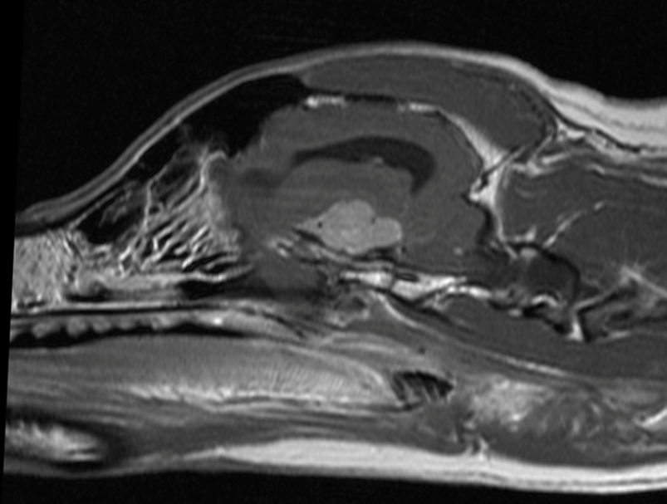

Slide 20
Case 5
Signalement:
1 year-old female-spayed German Shepherd dog
History:
came back from playing outside, not supervised, hard submandibular mass palpated

Slide 21
